Slide 1


Mastering AJAX & jQuery
Unlock dynamic web interactions with asynchronous JavaScript and efficient DOM manipulation.
Notes:
1

Slide 2

Introduction
Why AJAX & jQuery?
AJAX: Asynchronous JavaScript and XML. Enables web pages to update content without reloading, enhancing user experience. Crucial for dynamic applications.
jQuery: A fast, small, and feature-rich JavaScript library. Simplifies HTML document traversal and manipulation, event handling, animation, and, notably, AJAX interactions.
Notes:
2

Slide 3



Getting Started
Console Confirmation
Before diving deep, ensure your JavaScript is running correctly. A simple log confirms your setup.
console.log("We are working with AJAX!!!");
This message appears in your browser's console, verifying script execution.
Debugging
Code Check
Browser Console
Essential first step for any web project.
Confirms script linking and execution.
Your window into JavaScript's runtime.
Notes:
3

Slide 4

Handling Data
Form Submission: POST Request
Learn how to capture form data and prevent default browser behaviour for seamless submissions.
1
2
Event Listener
Prevent Default
$("#todoForm").submit(function (e) { ... });
e.preventDefault();
Stops the page from reloading, crucial for AJAX.
Activates when the form is submitted.
3
Get Input Values
let title = $("#title").val();let userId = $("#userId").val();
Captures data from form fields.
Notes:
4

Slide 5
POST Request Details
Preparing and Sending Data
Setting up your XMLHttpRequest for sending JSON data to an API.
Preparation
Sending
Create XMLHttpRequest object.
Construct JSON object with form data.
Open a POST request to the API endpoint.
Convert JSON object to a string using JSON.stringify().
Set 'Content-Type' header to 'application/json'.
Send the stringified data with xhr.send().
let xhr = new XMLHttpRequest();
xhr.open("POST", 'https://jsonplaceholder.typicode.com/todos', true);
xhr.setRequestHeader('Content-Type', 'application/json');
let param = JSON.stringify({
title: title,
userId: userId,
completed: false });
xhr.send(param);
Notes:
5

Slide 6
POST Request Details
Handling the Server Response
What happens when the server replies? Process the response and handle potential errors.
On Load Event
Status Check
xhr.onload = function () { ... };
if (this.status === 200)
Executes when the server sends a response.
Verifies a successful request (HTTP 200 OK).
Parse JSON
Error Handling
JSON.parse(this.responseText);
else { console.error("Something went wrong!", this.status); }
Transforms JSON string into a usable JavaScript object.
Catches and logs any non-200 responses.
Notes:
6

Slide 7
Fetching Data
GET Request: Retrieving Todos
Initiate a GET request to fetch data from an API and prepare it for display.
1
2
Button Click
New Request
$("#GetData").click(() => { ... });
let xhr = new XMLHttpRequest();
Triggers the data retrieval process.
Creates a fresh AJAX request object.
3
4
Open GET
Send Request
xhr.open("GET", "...", true);
xhr.send();
Configures a GET request to the specified API.
Dispatches the GET request to the server.
Notes:
7

Slide 8
GET Request Details
Processing and Displaying Data
Transform API responses into dynamic HTML content and render it on your page.
Processing Data
Creating HTML
Verify successful status (200 OK).
Loop through each todo item.
Parse JSON response into a JavaScript array.
Construct HTML list items (<li>).
Insert generated HTML into the #output element.
xhr.onload = function(){ if (this.status === 200) { let todos = JSON.parse(this.responseText); // ... }};
let html = "<h3>Todos:</h3><ul>";todos.forEach(todo => { html += `<li> <strong>${todo.title}</strong> - ${todo.id} </li>`;});html += "</ul>";$("#output").html(html);
Notes:
8

Slide 9
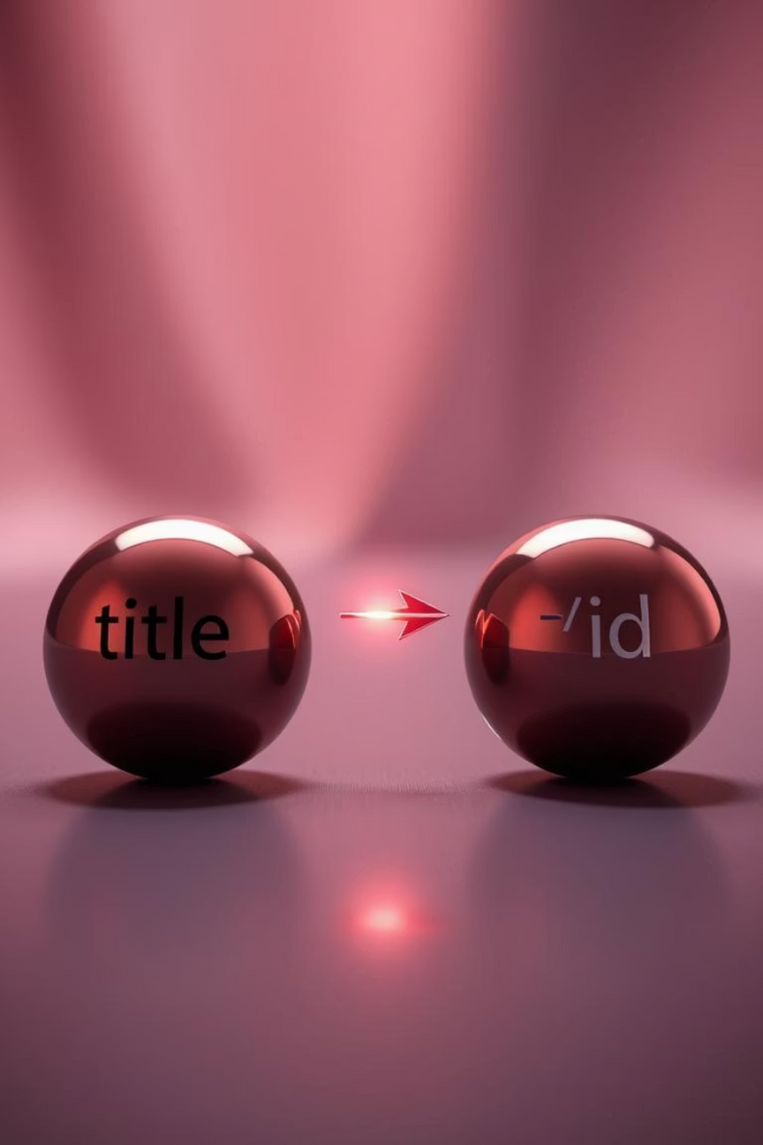
Important Note
Comma Operator Caution
Be aware of how the comma operator behaves in JavaScript when constructing strings.
${todo.title, todo.id} uses the comma operator and will only output todo.id.
For both title and ID, use: ${todo.title} - ${todo.id}
Notes:
9

Slide 10
Summary
Key Takeaways
A concise overview of handling POST and GET requests with AJAX and jQuery.
POST Request
GET Request
Captures form input.
Fetches todos from API.
Sends JSON data to API.
Generates dynamic HTML list.
Logs the server's response.
Displays content on the page.
Empower your web applications with dynamic content updates and seamless user experiences!
Notes:
10

